Slide 1
Tkinter vs. Pygame
Janabelle

Slide 2


Tkinter
Pygame
GUI Programming
Easier to learn and use
Documentation
https://www.tutorialspoint.com/python/python_gui_programming.htm
Complex and a lot of moving parts
More flexibility
To do anything you want
Documentation
https://www.pygame.org/docs/
Usually used for games

Slide 3

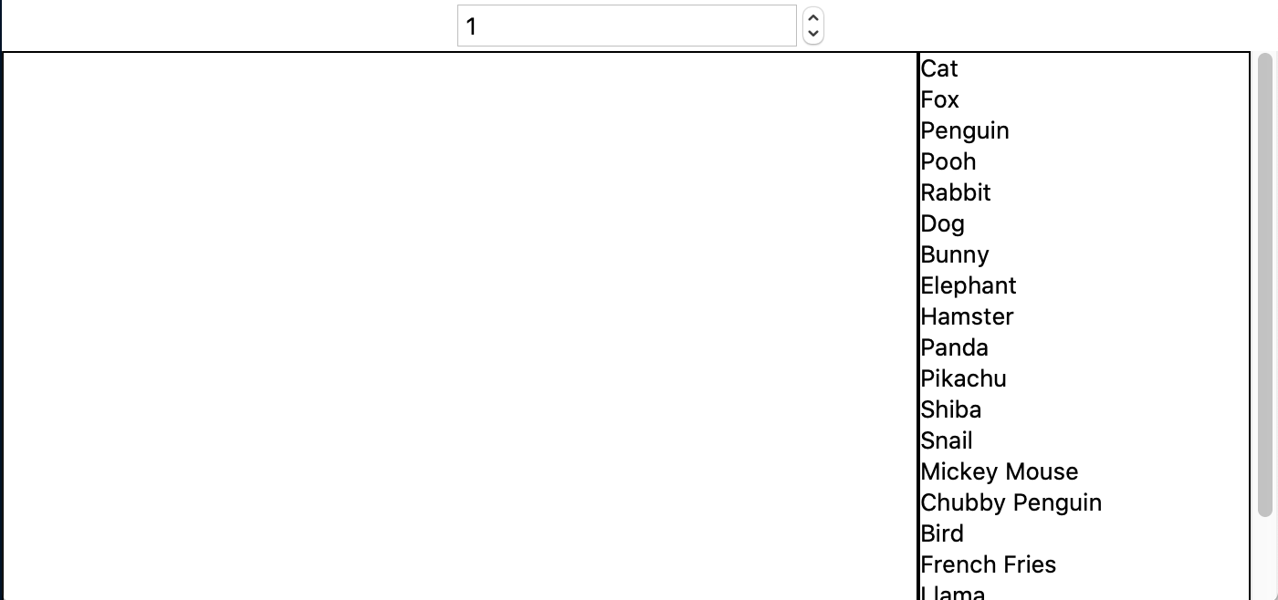
Tkinter
The list of all the widgets that we introduced and used in games
Easy and clear for the player or user to navigate around
Not always the prettiest
Radiobuttons
Listbox
Spinbox
ScrollBar
Label
Entry
Button
Canvas

Slide 4
Pygame
A lot more freedom
Usually made for games so a lot prettier looking
A lot more useful game related function
Most useful stuff:
Color | display | draw | event | font | image | key | locals | mixer | mouse | Rect | Surface | time | music | pygame
Advanced stuff:
cursors | joystick | mask | sprite | transform | BufferProxy | freetype | gfxdraw | midi | Overlay | PixelArray | pixelcopy | sndarray | surfarray | math
Other:
camera | cdrom | examples | fastevent | scrap | tests | touch | version

Slide 5
Pygame (Australian Fire)
Sometimes they are very similar
Tkinter:
root = Tk()
root.geometry("1000x800")
root.title("Australian Fires")
Pygame:
pg.init()
window = pg.display.set_mode((1000, 800))
pg.display.set_caption("Australian Fires")

Slide 6
Pygame (Australian Fire)
Similar Drawing
Tkinter:
canvas.create_rectangle(0, 0, 300, 250, fill="red", outline="red")
Pygame:
tree_scale_rect = tree_scale.get_rect(topleft=(x, y_global))
These are the same for all the other shapes
Text
Tkinter:
canvas.create_text(100,10,fill="black",font="Times 20 italic bold", text="Herro")
Pygame:
largeText = pg.font.Font('freesansbold.ttf', fontsize)
textSurface = largeText.render(text, True, (0, 0, 0))
textRect = textSurface.get_rect()

Slide 7
Pygame (Australian Fire)
Did not need to import PIL library, ImageTk, and Image to display images and resizing them
Tkinter:
image1 = Image.open("key.jpeg")
resized1 = image1.resize((300, 250))
img1 = ImageTk.PhotoImage(resized1)
Pygame includes functions to deal with images and resizing
Pygame:
fire_load = pg.image.load("fire.jpeg")
fire = pg.transform.scale(fire_load, (1000, 800))

Slide 8
Pygame (Australian Fire)
One example of game-related function is collidepoint()
Tkinter (from flappyBird)
if ((data.birdX + data.birdWidth > x) and
(data.birdX < (x + data.asteroidWidth)) and
(data.birdY + data.birdHeight > y) and
(data.birdY < (y + data.asteroidHeight))):
Pygame (from australianFires)
tree_rect.collidepoint(mouse_x, mouse_y)
Returns true if collided
Return false if is not collided

Slide 9
The End

